Slide 1



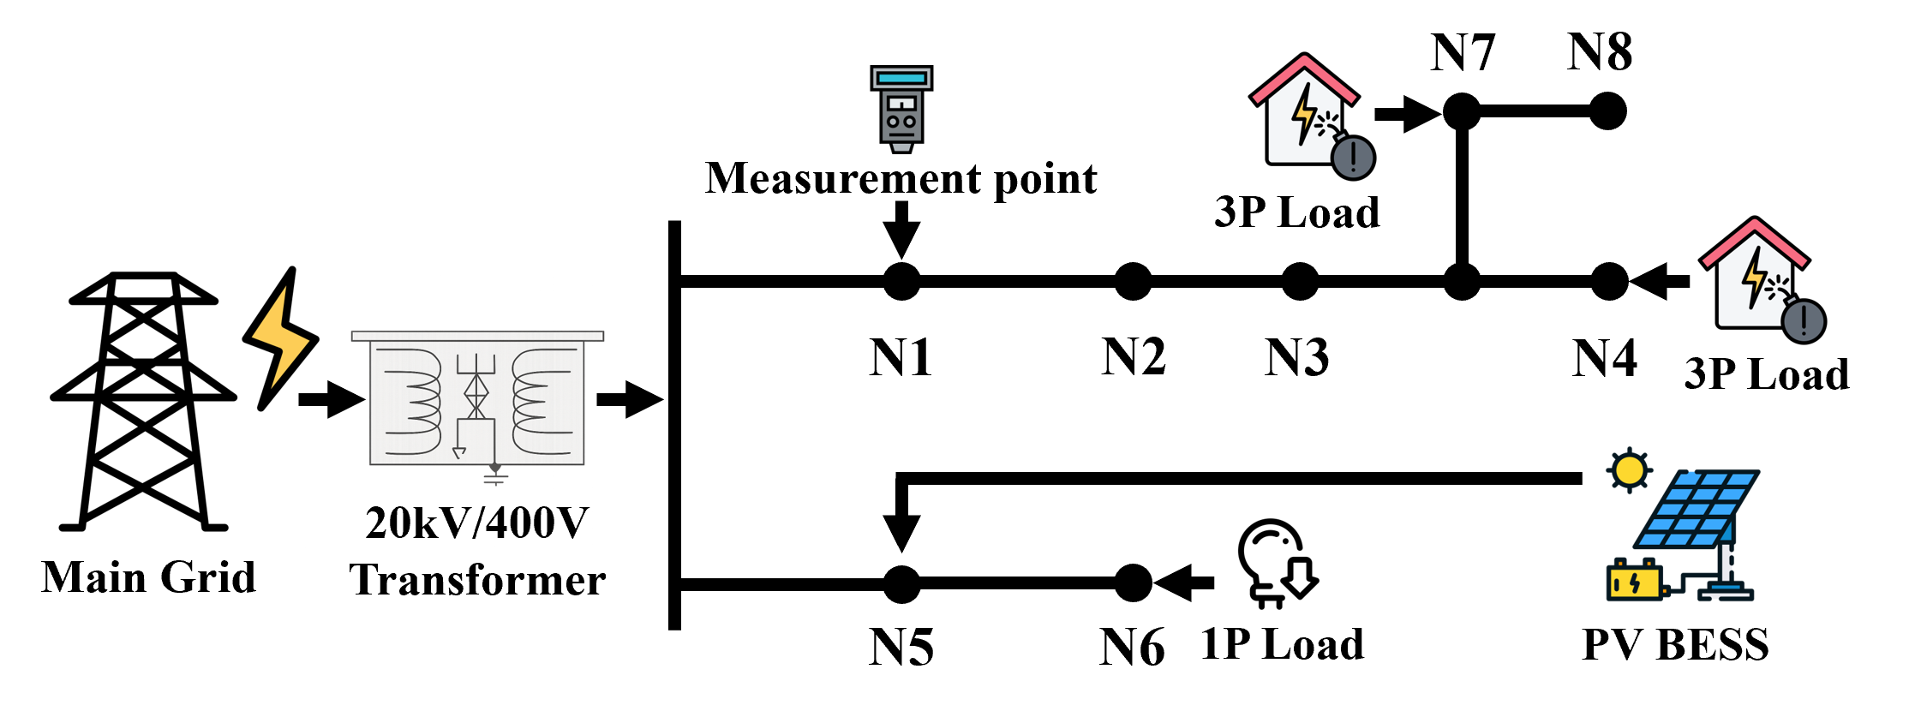
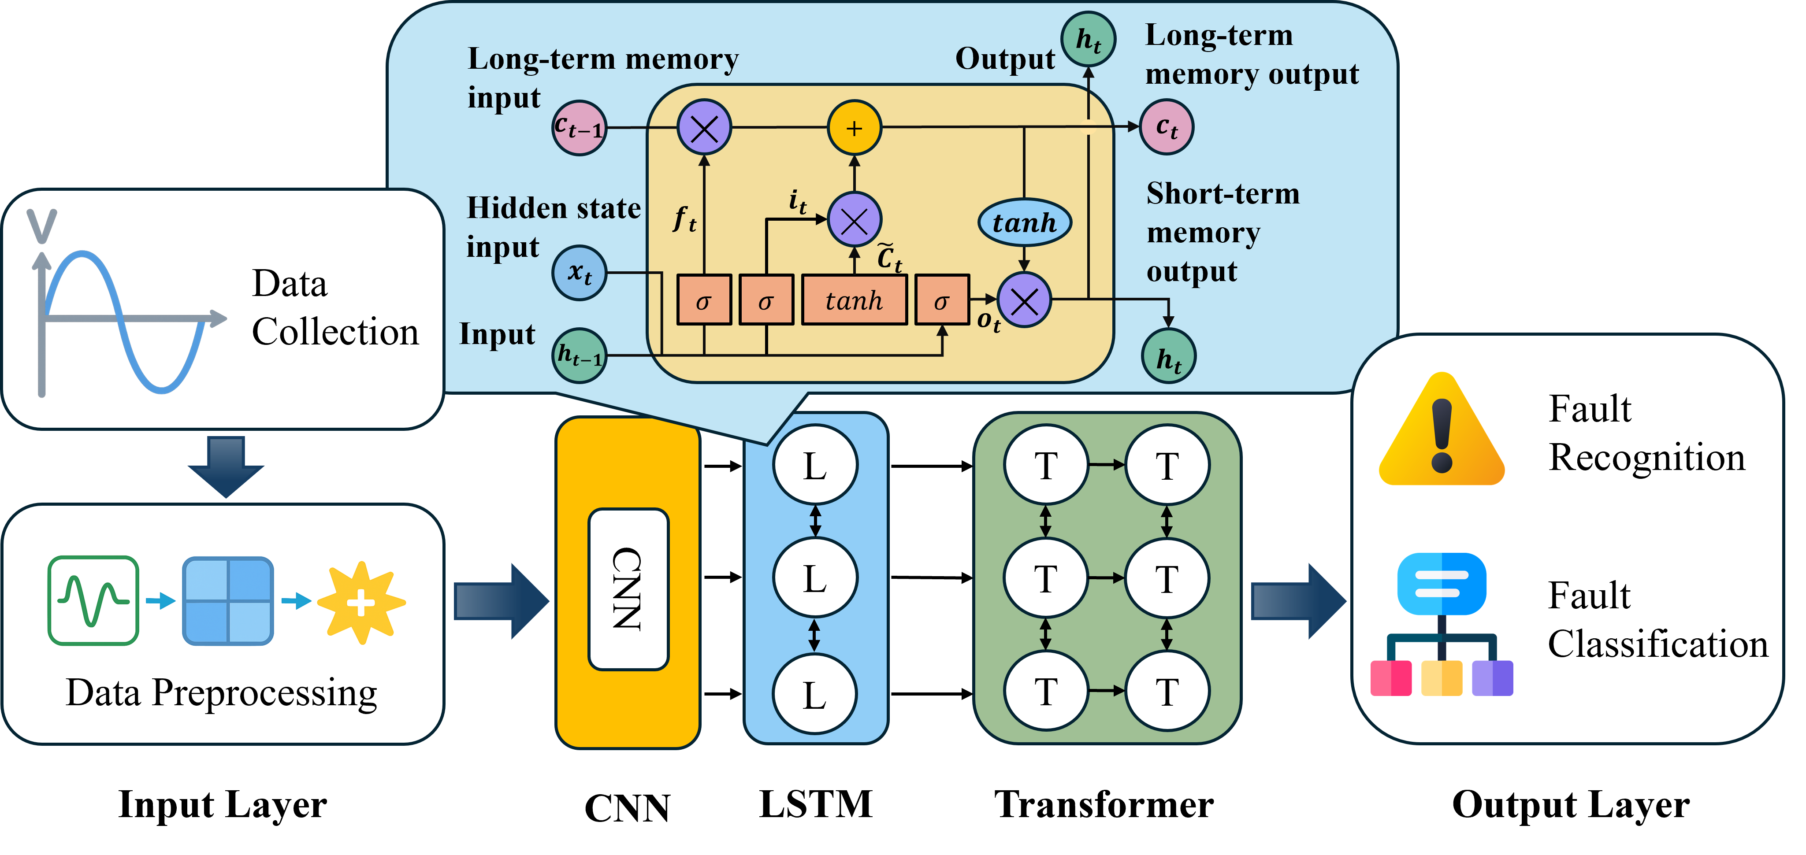
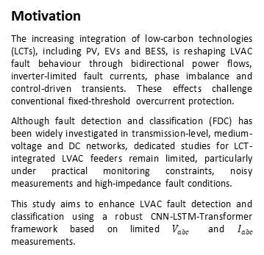
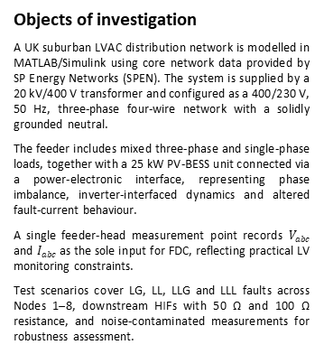
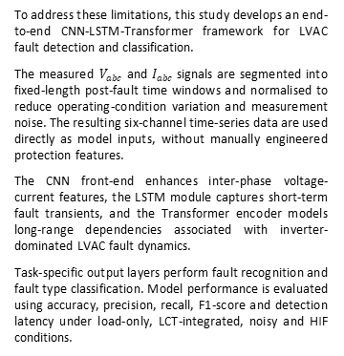
Study Committee B5
PROTECTION AND AUTOMATION
Paper ID: 12071
An Improved AI-Driven LVAC Network Fault Detection and Classification
James YU¹ | Francisco FILGUEIRA² | Mikaelle DINIZ³ | Yue QI⁴ | Jiwei LI⁴ | Miaorui MA⁴ | Jin YANG⁴
¹CIGRE UK | ²CIGRE SPAIN | ³Scottish Power Energy Networks UK | ⁴University of Glasgow UK
yugem@ hotmail.com | patxi.pazos@ yahoo.com | mlopes@ spenergynetworks.co.uk | yue.qi@ gla.ac.uk | jiwei.li.2@ gla.ac.uk | miaorui.ma@ gla.ac.uk | jin.yang@ gla.ac.uk
Motivation
The increasing integration of low-carbon technologies (LCTs), including PV, EVs and BESS, is reshaping LVAC fault behaviour through bidirectional power flows, inverter-limited fault currents, phase imbalance and control-driven transients. These effects challenge conventional fixed-threshold overcurrent protection.
Although fault detection and classification (FDC) has been widely investigated in transmission-level, medium-voltage and DC networks, dedicated studies for LCT-integrated LVAC feeders remain limited, particularly under practical monitoring constraints, noisy measurements and high-impedance fault conditions.
This study aims to enhance LVAC fault detection and classification using a robust CNN-LSTM-Transformer framework based on limited $V_{abc}$ and $I_{abc}$ measurements.
Method/Approach
Recent FDC approaches are summarised to clarify the methodological gap and motivate the proposed hybrid architecture.
Table 1. Overview of recent methods in power system FDC
Category | Representative Methods | Key limitations
Model- and signal-based methods | Observers; Time/frequency analysis | Parameter, feature and noise sensitivity
Knowledge- based | SVM, DT, ANN | Manual features; weak temporal modelling
Deep learning- based | CNNs, LSTMs, Transformers | Higher complexity; data dependence
Objects of investigation
A UK suburban LVAC distribution network is modelled in MATLAB/Simulink using core network data provided by SP Energy Networks (SPEN). The system is supplied by a 20 kV/400 V transformer and configured as a 400/230 V, 50 Hz, three-phase four-wire network with a solidly grounded neutral.
The feeder includes mixed three-phase and single-phase loads, together with a 25 kW PV-BESS unit connected via a power-electronic interface, representing phase imbalance, inverter-interfaced dynamics and altered fault-current behaviour.
A single feeder-head measurement point records $V_{abc}$ and $I_{abc}$ as the sole input for FDC, reflecting practical LV monitoring constraints.
Test scenarios cover LG, LL, LLG and LLL faults across Nodes 1–8, downstream HIFs with 50 Ω and 100 Ω resistance, and noise-contaminated measurements for robustness assessment.
To address these limitations, this study develops an end-to-end CNN-LSTM-Transformer framework for LVAC fault detection and classification.
The measured $V_{abc}$ and $I_{abc}$ signals are segmented into fixed-length post-fault time windows and normalised to reduce operating-condition variation and measurement noise. The resulting six-channel time-series data are used directly as model inputs, without manually engineered protection features.
The CNN front-end enhances inter-phase voltage-current features, the LSTM module captures short-term fault transients, and the Transformer encoder models long-range dependencies associated with inverter-dominated LVAC fault dynamics.
Task-specific output layers perform fault recognition and fault type classification. Model performance is evaluated using accuracy, precision, recall, F1-score and detection latency under load-only, LCT-integrated, noisy and HIF conditions.
Figure 1. Topology of the studied UK LVAC network
Figure 2. The proposed CNN-LSTM-Transformer model for LVAC FDC

Slide 2
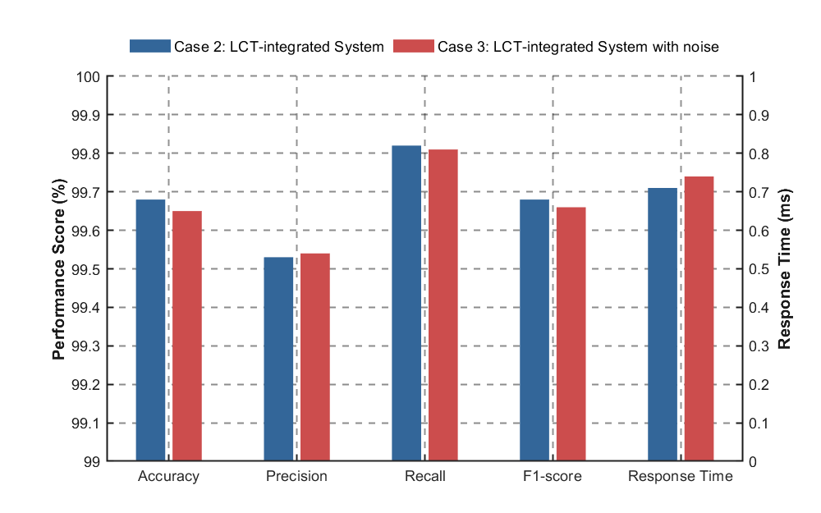
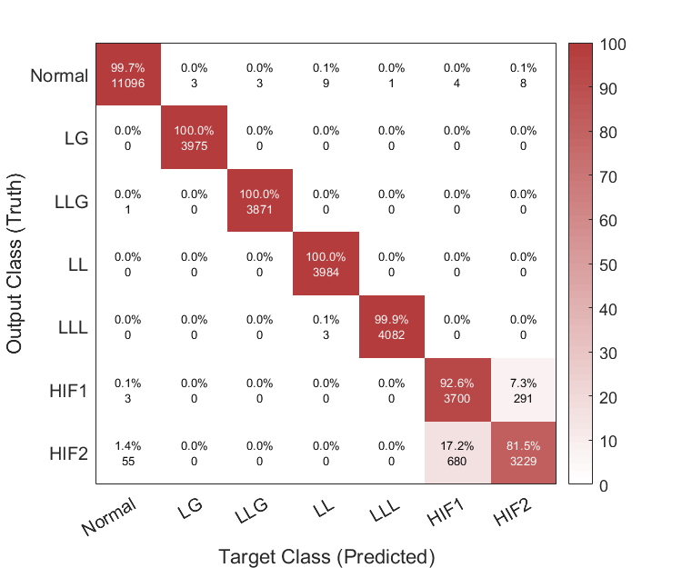
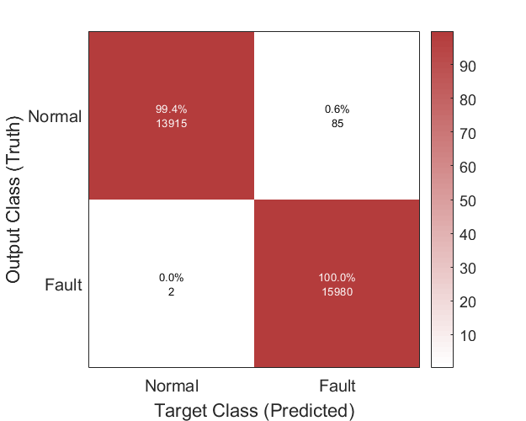
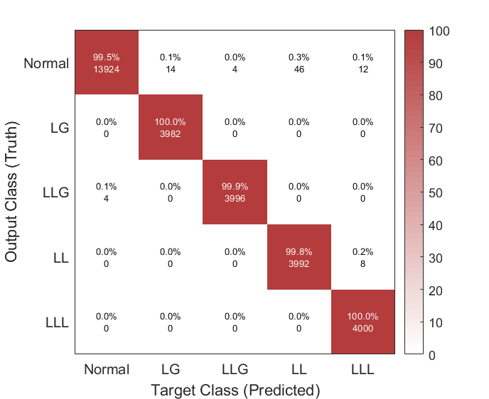
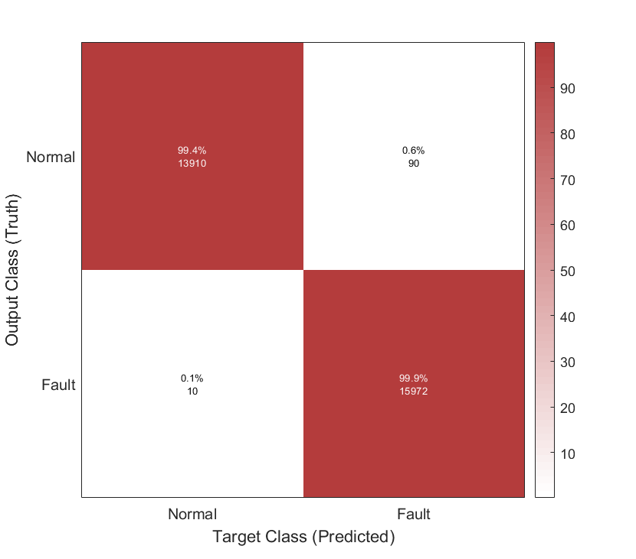
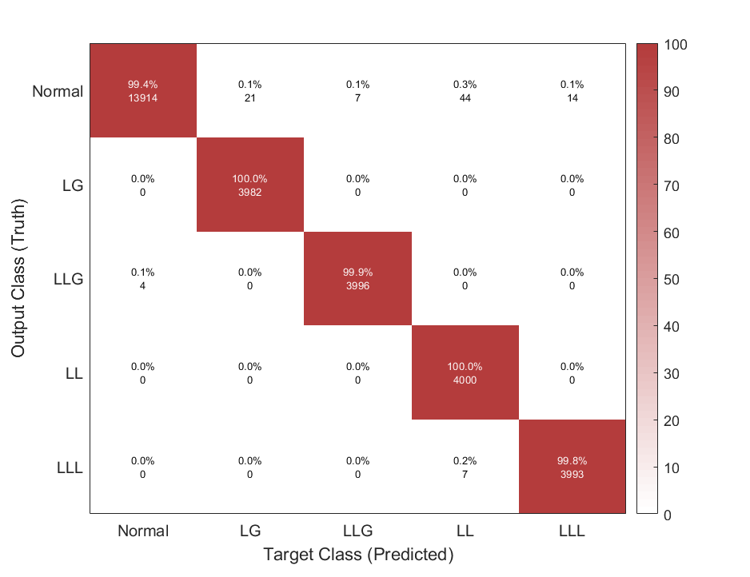
Study Committee B5
PROTECTION AND AUTOMATION
Paper ID: 12071
An Improved AI-Driven LVAC Network Fault Detection and Classification
Experimental setup & test results
Four controlled case studies are designed to evaluate the accuracy, robustness and response performance of the proposed CNN-LSTM-Transformer FDC framework under practical LVAC operating conditions.
Table 2. Experimental case studies for LVAC FDC
Case | Test condition | Key purpose
1 | Load-only LVAC | Baseline FDC performance
2 | LCT-integrated | Impact of inverter-interfaced dynamics
3 | Noisy LCT- integrated | Robustness to measurement uncertainty
4 | HIF, 50 Ω / 100 Ω | Recognition of weak fault signatures
Figure 5. Noise robustness under LCT-integrated operation.
Under conventional load-only operation, the model achieves 100.0% fault detection accuracy and fault classification accuracies above 99.7%, with an average detection latency of 0.14 ms.
With LCT integration, reliable FDC performance is maintained despite inverter-driven waveform distortion. Classification metrics remain above 99.5%, and the average detection latency increases modestly to 0.71 ms.
Under noisy measurements, only marginal variations are observed in accuracy, precision, recall and F1-score, confirming strong robustness against sensing uncertainty.
For HIF conditions, subclass confusion occurs between 50 Ω and 100 Ω faults due to similar electrical characteristics. When merged into a single HIF category, the overall HIF recognition accuracy reaches approximately 99%.
Figure 6. HIF classification performance.
Discussion
LCT integration slightly reduces classification performance and increases detection latency from 0.14 ms to 0.71 ms, which is expected due to inverter-driven transients and reduced fault-current visibility.
The stable performance under noisy measurements indicates that the proposed framework extracts robust spatio-temporal fault features rather than relying only on current magnitude or manually engineered indicators.
HIF subclass confusion is expected because different impedance levels produce similar weak fault signatures; however, the merged HIF recognition accuracy of approximately 99% is more relevant for practical LV protection.
Conclusion
A CNN-LSTM-Transformer FDC framework is developed for LCT-integrated LVAC networks under limited monitoring conditions.
The framework shows near-perfect FDC performance under load-only operation, with approximately 100% faulted-sample detection and 99.4% normal-state identification, while maintaining classification metrics above 99.5% under LCT integration.
Results under noisy measurements and HIF conditions demonstrate strong robustness, supporting data-driven protection for future LVAC networks.
Figure 3. Baseline FDC performance under load-only operation.
Figure 4. FDC performance under LCT-integrated operation.

